Slide 1

Trauma-Sensitive
Schools
Notes:
Ways to use this resource
This resource can be used to guide self-reflection, peer-to-peer learning and staff learning in support of building trauma-sensitive schools
This slide deck can be used in one session, or over several sessions as needed
The framework includes principal-specific language which you may want to adapt when working with other education groups (Slide 8)
Consider this in the context of your school - what is the current level of understanding and integration? What’s going well? What’s an area for growth?
Connect to existing Tier One work
Reinforce the importance of self-care for educators
Key Messages:
School staff are familiar with the term “trauma-informed” and have implemented approaches that are responsive to the impact of trauma in school communities.
There has been increasing emphasis on trauma informed practice in Ontario schools in the past several years.
For many years, School Mental Health Ontario has been using the term “mentally healthy school” to reflect this thinking and practice. However, this connection to trauma-sensitive practice may not have been as explicit as it could be. This presentation aims to strengthen those connections.

Slide 2
Learning Goals
Understand the shift in language from trauma-informed to trauma-sensitive approaches, including the rationale and implications for daily practice.
Consider Tier One practices through a trauma-sensitive lens, highlighting strategies that promote identity-affirming, supportive classroom environments for every student.
Explore and apply SMH-ON’s principles of trauma-sensitive practice to better understand how to effectively support student well-being, safety, and engagement.
Provide opportunities to access and engage with SMH-ON resources to deepen understanding of trauma-sensitive practices and support ongoing professional learning.
Notes:
FACILITATOR GUIDE
Suggested timing: 2–3 minutes
Facilitator tips:
• Briefly explain that the session focuses on strengthening Tier One environments.
• Emphasize that trauma‑sensitive practice benefits all students and staff.
• Invite staff to listen, reflect, and connect ideas to their own classroom practice.

Slide 3
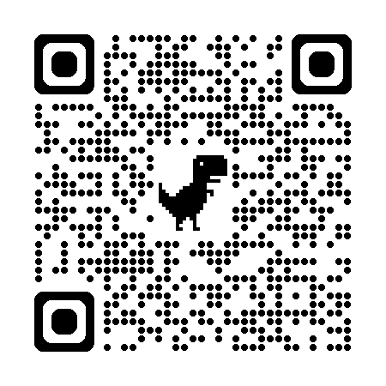
Understanding Trauma
“Trauma is the lasting emotional response that often results from living through a distressing event. Experiencing a traumatic event can harm a person’s sense of safety, sense of self, and ability to regulate emotions and navigate relationships. Long after the traumatic event occurs, people with trauma can often feel shame, helplessness, powerlessness and intense fear.” Centre for Addiction and Mental Health (CAMH)
What are some ways trauma might show up in a classroom or
school environment?
Notes:
FACILITATOR GUIDE
Suggested timing: 4–5 minutes
Key message:
Trauma may influence how students respond to stress, relationships, and learning environments.
Trauma is the lasting emotional response to distressing events
It can affect safety, identity, emotional regulation, and relationships
Impacts may appear in behaviour, learning, and social interactions
Any member of the school learning community including staff can be affected by vicarious trauma making self care practices essential
Facilitator tip:
Encourage staff to focus on understanding behaviour as communication rather than labeling behaviour.

Slide 4
From Trauma-informed to Trauma-sensitive
Trauma-informed refers to the systemic, policy-integrated and organization-wide infrastructure built around trauma awareness.
Trauma-sensitive reflects a strong commitment to building a culture and practice of promoting safety and empathy for all members of school learning communities.
Being trauma-sensitive is a mindset and way of being that allows us to more consistently respond with calm, care, compassion, and connection.
Notes:
FACILITATOR GUIDE
Suggested timing: 2-3 minutes
Key message:
Trauma may influence how students respond to stress, relationships, and learning environments.
Facilitator tip:
Encourage staff to focus on understanding behaviour as communication rather than labeling behaviour.

Slide 5
Why Trauma-Sensitive Schools Matter
Students learn best when they feel safe, calm, and connected.
Trauma can affect attention, memory, behaviour, and relationships.
Schools can intentionally create supportive environments.
It isn’t necessary to know the trauma story in order to support.
Notes:
FACILITATOR GUIDE
Suggested timing: 3–4 minutes
Key message:
Conditions for learning include emotional safety and connection.
Educators don’t always need to know a student’s trauma story in order to be in a position to help
Discussion prompt as a whole group:
• Think about a time when a student seemed more successful after feeling understood or supported.

Slide 6
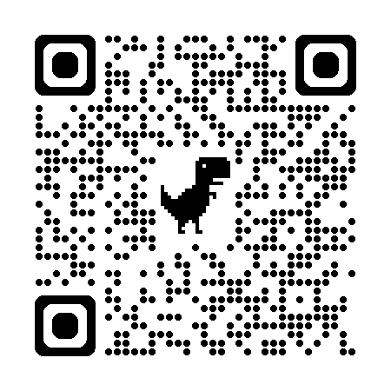
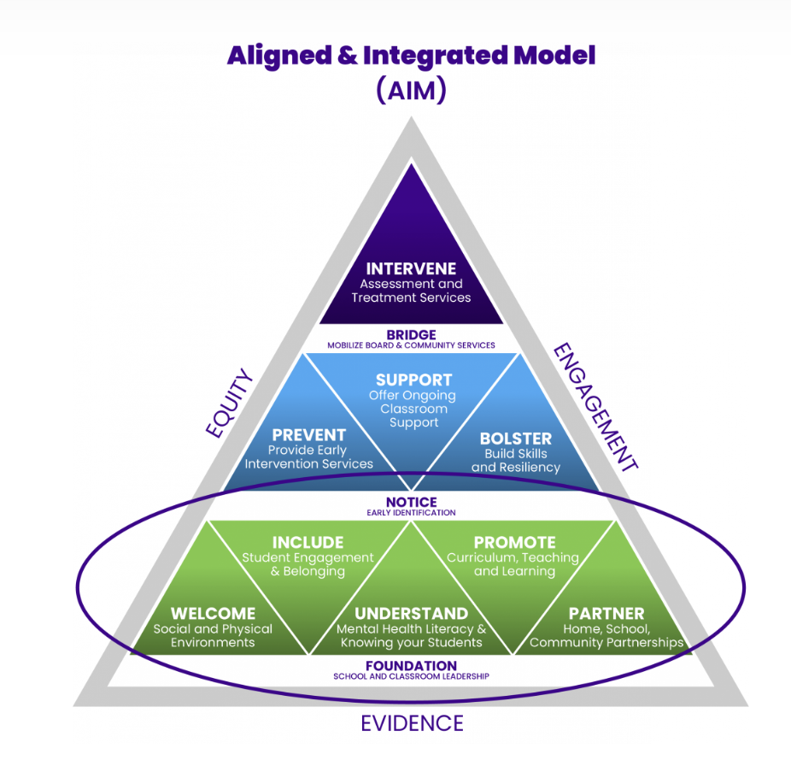

Tier One is Everyone’s Work
At the Tier One level, staff implement universal strategies that benefit all students, regardless of their known trauma history. These practices focus on creating a safe, predictable, and supportive environment that prevents crises and builds resilience.
(Source: SMH-ON)
Notes:
FACILITATOR GUIDE
Suggested timing: 2-3 minutes
Key messages:
Across the globe, a multi-tiered system of support approach is seen as foundational for school mental health service delivery. This structure helps to establish priorities, clarify roles, and ensure service coordination and quality within a complex and evolving field. Broadly, it includes a continuum of services: mental health promotion, early identification, prevention and early intervention, and service pathways / clinical support for more intensive mental health needs.
SMH-ON’s Mental Health Promotion (Tier 1): Focuses on creating mentally healthy classrooms and schools for all students.
educators do not need to know individuals' trauma experiences to be supportive and emphasize Tier One trauma-sensitive strategies.
Prevention and Early Intervention (Tier 2): Provides targeted supports for some students who may be at risk or showing early signs of mental health concerns.
Intervention and Treatment (Tier 3): Offers intensive, specialized support for the few students who need it, often in collaboration with community partners.
Trauma Sensitive work also happens at the Tier 2 and 3 level but today we are addressing it at a Tier 1 level
Recall SMH-ON’s AIM Model (QR code above)
Highlight that this is something we already do every day - it isn’t new.

Slide 7
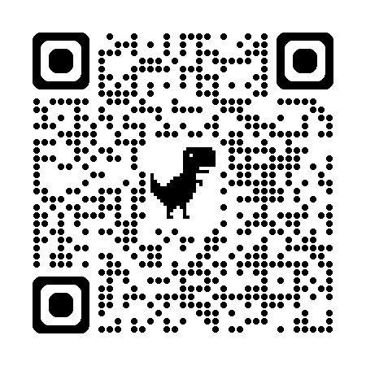
Tier One Practices with a Trauma-Sensitive Lens
A Trauma-sensitive approach incorporates Tier One level practices:
Focus on cultivating a culture of safety, empathy, and predictability regardless of known/unknown trauma history.
Grounded in the belief that all students benefit from safe and supportive environments that prevent crisis and build resiliency.
Staff act in a supportive role, not as clinicians, creating a strong sense of connectedness and belonging.
Notes:
FACILITATOR GUIDE
Suggested timing: 3–4 minutes
Key message:
Staff are not expected to be therapists. Their role is to create supportive environments.
Discussion prompt as a whole group:
• What are examples of Tier One practices that promote belonging in our school?
Optional: Other tier one level supports to remind staff about : https://smho-smso.ca/wp-content/uploads/2020/08/Tip-sheet-positive-mental-health.pdf

Slide 8
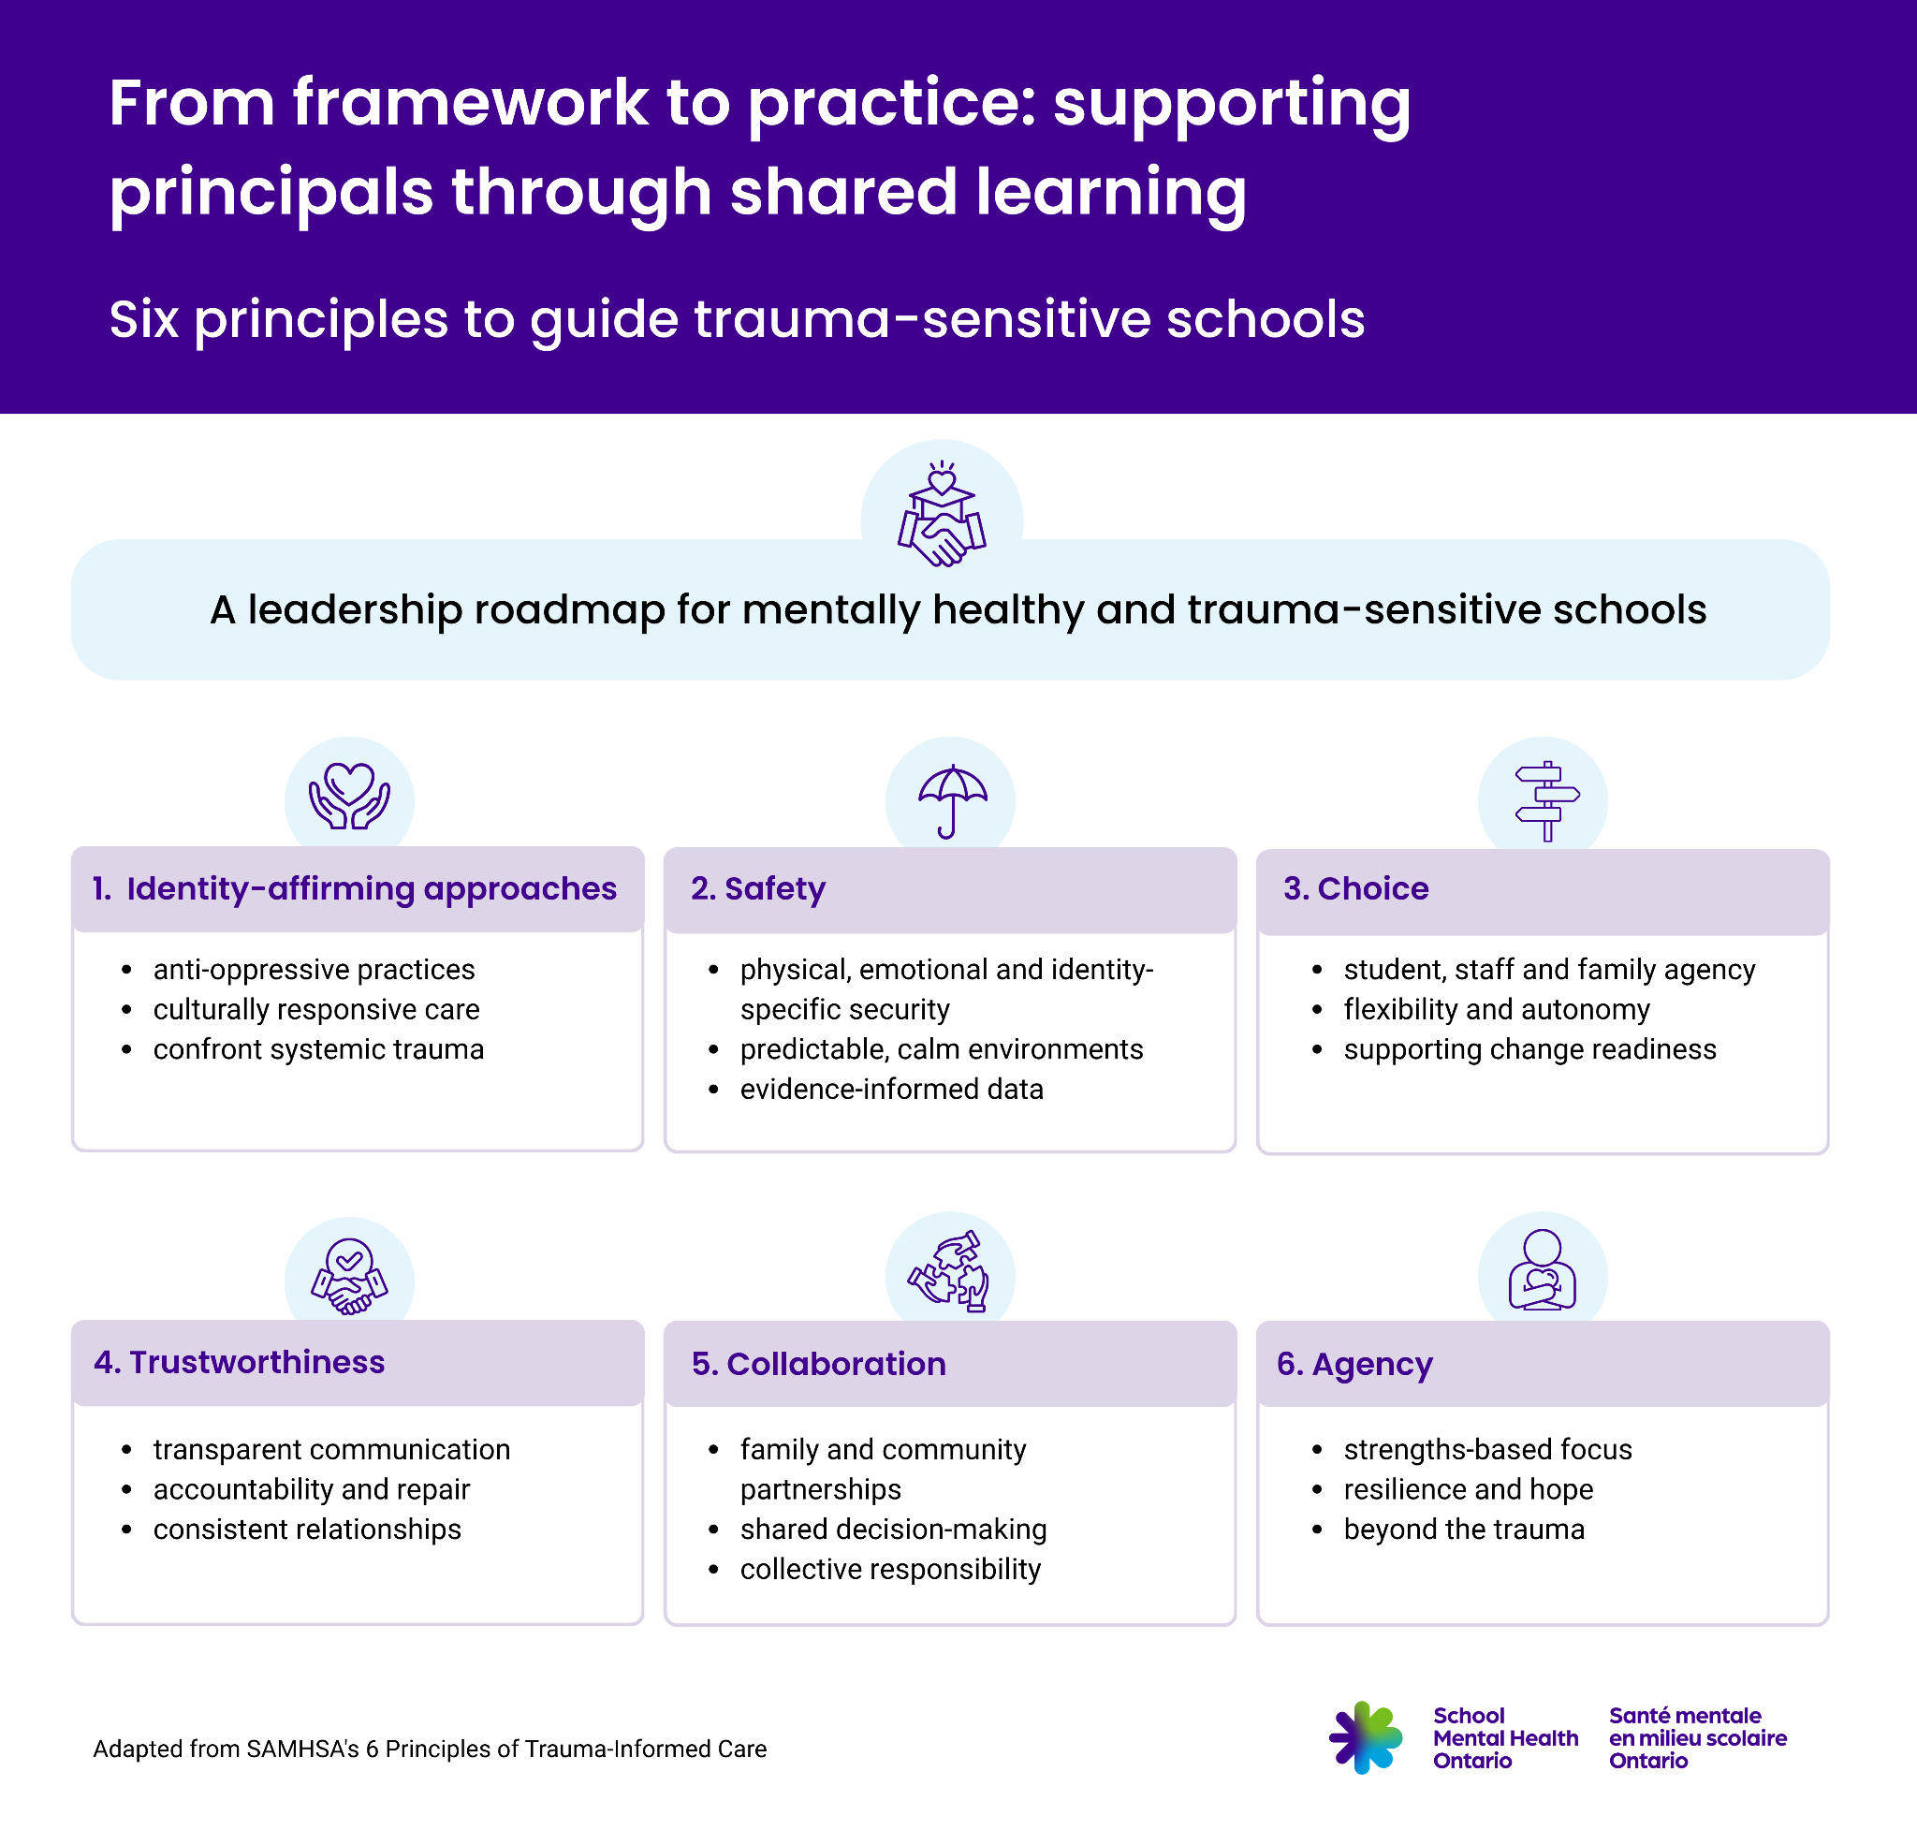
Notes:
FACILITATOR GUIDE
Suggested timing: 3–4 minutes
Key message:
Staff are not expected to be therapists. Their role is to create supportive environments.
Discussion prompt as a whole group:
• What are examples of Tier One practices that promote belonging in our school?
Optional: Other tier one level supports to remind staff about : https://smho-smso.ca/wp-content/uploads/2020/08/Tip-sheet-positive-mental-health.pdf

Slide 9

SMH-ON Six Principles to Guide Trauma-Sensitive Schools
Principle #1: Identity-Affirming
In our school, we endeavour to employ identity-affirming approaches to trauma that recognize and address stereotypes, biases by offering responsive services that leverage healing practices and acknowledge historical trauma.
How might we honour stories and lived experiences of others?
How might we support the understanding of personal identities and the impact on the school community?
How might our identities impact relationships and community-building? What evidence might there be to confirm this?
Notes:
FACILITATOR GUIDE
Suggested timing per question: 5-7 minutes
Key messages:
Identity‑affirming practice recognizes how identity and lived experiences influence belonging and opportunity.
Encourage staff to think about classroom practices, curriculum choices, and school culture.
Optional: SMH-ON • Cultural Humility Self-Reflection Tool for School Staff
School Mental Health Ontario’s Identity-affirming frame

Slide 10

SMH-ON Six Principles to Guide Trauma-Sensitive Schools
Principle #2: Safety
Schools aspire to be places of safety for students, and this will look different for each student and staff member. Dimensions of safety can include emotional, psychological, social, spiritual, cultural, moral and physical - as well as being mindful of each individual’s multiple and intersecting identities.
How do we know if students feel safe?
Where might additional supports be needed in order to develop co-regulation?
Notes:
FACILITATOR GUIDE
Suggested timing per question: 5-7 minutes
Key messages:
Safety includes emotional, cultural, social, and physical dimensions
Students experience safety differently based on identity and experiences
Schools and districts have various data sources to inform and guide responses
Compassionate responses support belonging
Encourage teams to consider classroom routines, hallway interactions, and adult responses.
Optional: SMH-ON My Circle of Support - junior • Educator Guide
SMH-ON My Circle of Support Educator Pocketbook Guide

Slide 11

SMH-ON Six Principles to Guide Trauma-Sensitive Schools
Principle #3: Choice
In our school, we aim to support students and families in determining what is right for them. This may include providing information about their choices, creating opportunities for their voices, listening and being open minded in order to support them.
In what ways does oppression related to identity impact access to choice, voice and influence?
How might we enhance opportunities for choice, voice, and influence?
As educators, how might we help prepare students for change so that it feels predictable rather than threatening?
Notes:
FACILITATOR GUIDE
Suggested timing per question: 5-7 minutes
Key messages:
Choice increases engagement and reduces feelings of powerlessness.
Students and families benefit from opportunities to influence decisions
Multiple pathways for feedback support inclusion
Empowerment and validation strengthen engagement
Optional - SMH-ON Fostering Supportive Responsive Spaces for Student Engagement
SMH-ON Foundations of Effective Student Engagement

Slide 12

SMHON Six Principles to Guide Trauma-Sensitive Schools
Principle #4: Trustworthiness
Staff aims to create a culture of connection, belonging, trustworthiness and transparency, where students, families and staff have a voice and feel heard through engagement in various committees and consultations, both formally and informally. This includes how conflict is addressed and resolution is created.
How might communication promote clarity, compassion, and transparency?
In what ways might trauma-sensitive language be used to help others feel safe rather than scrutinized?
Notes:
FACILITATOR GUIDE
Suggested timing per question: 5-7 minutes
Key messages:
Trust grows when leadership actions are predictable and transparent.
Build strong relationships with students, staff, and families
Communicate clearly and consistently
Model accountability and restore relationships when harm occurs
Optional - SMH-ON The 6Rs of Connection - A Guidance Educator's Resource

Slide 13

SMHON Six Principles to Guide Trauma-Sensitive Schools
Principle #5: Collaboration
In our school, we strive to offer meaningful engagement opportunities within existing boundaries and structures. Collaboration includes providing information in advance of changes and seeking feedback before decisions are made and when possible, exploring other possibilities, acknowledging power imbalances.
How might trauma-sensitive principles be incorporated into collaborative discussions?
Who is included in the collaboration, and who may still be missing?
Notes:
FACILITATOR GUIDE
Suggested timing per question: 5-7 minutes
Key messages:
Collaboration builds stronger solutions and shared responsibility.
Encourage staff to reflect on committees, student leadership, and parent engagement.
Optional - School Mental Health Ontario Launches By Your Side Toolkit and Parent / Caregiver Learning Hub to Strengthen Student Mental Health and Well-Being

Slide 14

SMHON Six Principles to Guide Trauma-Sensitive Schools
Principle #6: Agency
We endeavour to support students and families, especially those with a history of trauma, to recognize their unique strengths, building on their existing resilience, affirming their identities, and providing a sense of hope for their future.
What are some ways we might welcome, include and develop agency among students and families?
What might be noticed when people experience agency within a trusting environment?
Notes:
FACILITATOR GUIDE
Suggested timing per question: 5-7 minutes
Key messages:
Agency helps individuals feel capable, valued, and hopeful.
Encourage examples from classroom practice.
Optional - SMH-ON Actions of a Caring Adult in Student Engagement Initiatives Related to Mental Health

Slide 15

Reflection and Next Steps
3 connections I have made with my existing practices.
2 new ideas that I will integrate into my practice going forward. How will I know the impact?
1 area that I would like to learn more about.
Notes:
FACILITATOR GUIDE
Suggested timing: 10 minutes
Key messages:
Reflection is key to professional growth
Change in practice is the goal
Holistic approach to addressing student needs and enhancing wellbeing
Consider popping out thoughts regarding the one area people would like to learn more about

Slide 16
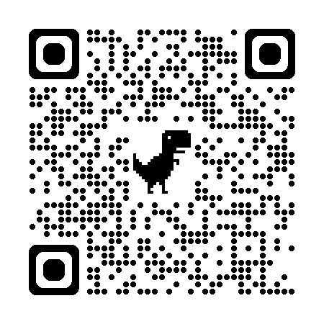
Self Care
What do I do daily that helps bring calm to my day?
Where are there opportunities for me to build personal wellness habits into my daily routine?
What is one commitment I can make to increase my daily wellness?
Notes:
FACILITATOR GUIDE
Suggested timing: 10 minutes
Key messages:
Educators must care for their own well-being to effectively support students and families.
When we treat ourselves with compassion it allows us to be accepting of ourselves, set reasonable expectations, and give ourselves permission to focus on what we need.
Understanding ourselves is being attuned to our feelings, and the connections between our feelings, thoughts and our actions. Self-awareness allows us to better understand our expectations, boundaries, and our needs; reminding us when we need to slow down.
SMH-ON Take Care of Yourself

Slide 17
Supportive Resources
The First 10 Days and Beyond: Building Connections and Supporting Student Well-Being - Guidance for educators to create caring and mentally healthy classroom environments early in the year.
Starting the Year Well – Five Days of Activities to Build Connection and Calm - Structured activities to begin the school year or semester while supporting mental health and belonging.
Listen, Believe & Act - Support for students who have been disproportionately impacted in schools - Information sheet to help educators respond to students affected by inequities or discrimination.
Promoting and Supporting Safe Spaces for Black Students - Guidance for creating affirming spaces that support Black students’ mental health and belonging.
Identity-Affirming School Mental Health Framework - Framework describing identity-affirming approaches to student mental health.
Supporting Students After a Tragic Event - Guidance for educators and school teams following tragic events that affect students or communities.
Supporting Conversations with Students About Distressing World Events - Strategies for discussing global events that may cause anxiety or concern for students.
Supporting Minds Strategies at a Glance - - Targeted strategies to support mental health (recognizing anxiety, emotional regulation…).
Supporting Student Leadership and Engagement Initiatives : Guidance to help schools create supportive environments for student leadership and voice.
Grab-and-Go Mental Health Activities - Ready-to-use activities that help strengthen well-being, emotional safety and student agency.
Connect Quest -Student-driven activities designed to strengthen connection and belonging.

